Slide 1


IPL Data Analysis: Building a Winning Strategy for RCB
Shubham Prasad Kuiri

Slide 2

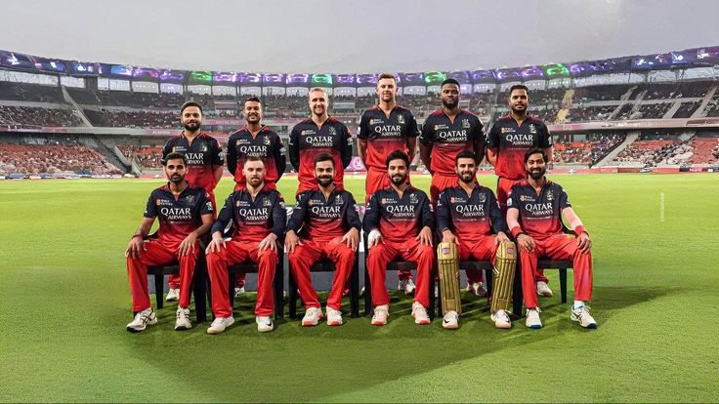
About RCB
Royal Challengers Bangalore (RCB) is one of the most recognized IPL franchises, known for its strong brand value and star-studded lineups. Over the years, RCB has delivered several standout individual performances and consistently remained competitive. However, despite the presence of top-tier talent, the team has been unable to convert performance into an IPL title. This gap between individual brilliance and team success makes RCB a compelling case for data-driven strategic analysis.

Slide 3
Problem Statement
You are hired as a sport data analyst by RCB where the team is looking for top-performing and reliable players to win tournaments, considering both on-field performance and value for money in mega player auction of 2017.
Your task is to come up with strategies/suggestions regarding selecting the best-performing players and optimizing player auction investments.
Objective Statement
To identify high-impact, reliable, and cost-effective players and strategies that can improve RCB’s chances of winning future IPL tournaments.

Slide 4
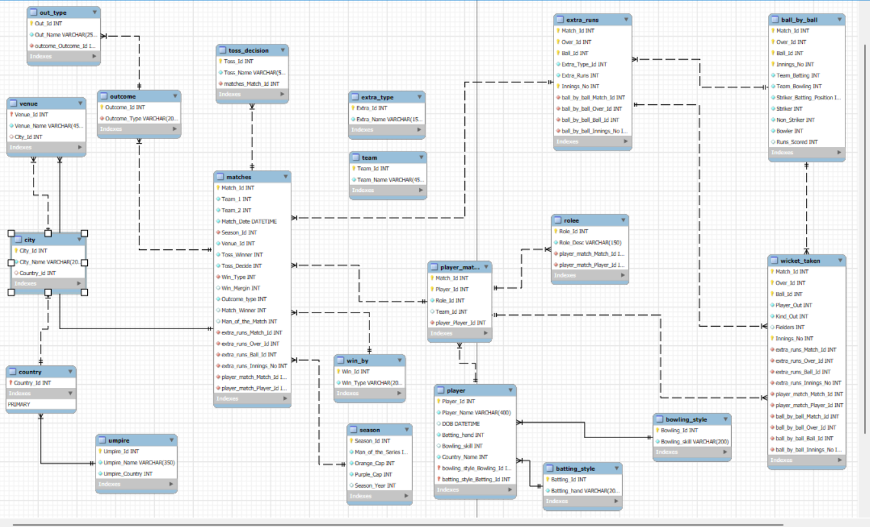
Database schema

Slide 5
IPL Dataset Overview
Ball by Ball
Match_id: Unique identifier for a cricket match
Over_id: Unique identifier for an over in a cricket match
Ball_id: Unique identifier for a ball in an over
Innings_No: The innings number in a cricket match
Team_Batting: The team batting in a particular innings
Team_Bowling: The team bowling in a particular innings
Striker_Batting_Position: The batting position of the striker batsman
Striker: The batsman currently on strike
Non_Striker: The batsman currently at the non-striker's end
Bowler: The bowler bowling the current delivery
Batting style
Batting_id: Unique identifier for a batsman's batting record
Batting_hand: The batting hand (right or left) of a batsman
Bowling style
Bowling_id: Unique identifier for a bowler's bowling record
Bowling_skill: The bowling skill (e.g., right-arm fast, left-arm spin) of a bowler
City
City_id: Unique identifier for a city
City_Name: The name of a city
Country_id: Unique identifier for a country

Slide 6
IPL Dataset Overview
Extra Type
Extra_Type_Id: Unique identifier for the type of extra runs scored in a cricket match.
Extra_Runs: The number of extra runs scored in a particular delivery.
Innings_No: The innings number in a cricket match.
Extra_Id: Unique identifier for an instance of extra runs scored.
Extra_Name: The name or description of the type of extra runs scored (e.g., byes, leg byes, wides, no-balls).
Season
Season_Id: Unique identifier for a particular season or tournament.
Venue_Id: Unique identifier for the venue or stadium where the match is played
Win_By
Win_Type: The type of win (e.g., runs, wickets) achieved by the winning team.
Win_Margin: The margin of victory (e.g., runs or wickets) for the winning team.
Outcome
Outcome_type: The type of outcome or result of the match (e.g., win, loss, tie, no result).
Match_Winner: The team that won the match.
Man_of_the_Match: The player awarded the Man of the Match award.
Out_Type
Out_Id: Unique identifier for the type of dismissal or way a batsman got out.
Out_Name: The name or description of the type of dismissal (e.g., caught, bowled, lbw, run out).
Outcome_Id: Unique identifier for the outcome or result of a match.

Slide 7
IPL Dataset Overview
Rolee
Role_Id: Unique identifier for a player's role or skills (e.g., batsman, bowler, all-rounder).
Role_Desc: Description of a player's role or skills.
Man_of_the_Series: The player awarded the Man of the Series award for a particular tournament.
Orange_cap: The player awarded the Orange Cap (for most runs scored) in a particular tournament.
Purple_cap: The player awarded the Purple Cap (for most wickets taken) in a particular tournament.
Team
Team_Id: Unique identifier for a team.
Team_Name: The name of a team.
Player
Player_Id: Unique identifier for a player.
Player_Name: The name of a player.
Umpire
Umpire_id: Unique identifier for an umpire officiating the match.
Umpire_name: The name of an umpire.
Umpire_country: The country or nationality of an umpire.
Toss Decision
Toss_Name: The name or description of the toss (e.g., heads or tails).
Extra Runs
Ball_Id: Reference to the specific ball during which extra runs were conceded.
Extra_Type_Id: Type of extra run (e.g., wide, no-ball).
Innings_No: The innings number during which the extra run occurred.
Match_Id: Reference to the match in which the extra runs were conceded.

Slide 8

Methodology
Data Cleaning: Thoroughly checked the entire dataset for any inaccuracies, but the data is clean.
Data Aggregation: Used various aggregation functions such as count(), sum(), avg(), etc. to aggregate the data and get the meaningful summary.
Data Manipulation: Created a view named “all_data” by using using joins, and also used sub-queries for easier analysis.
Data Measurement: Measured the data of various players by using aggregation functions and other functions like limit, window rank functions, etc.
Data Visualization: Used Excel for visualization of outputs to summarize the data, gain meaningful insights, and identify any trends.

Slide 9
RCB PERFORMANCE RECORD
RCB BATTING RECORD
Total runs increased steadily, peaking in 2016.
Batting capability strengthened over time.
Higher run totals did not ensure consistent wins.
Headline Insight
Batting Strength Did Not Translate into Championships

Slide 10
RCB PERFORMANCE RECORD
RCB BOWLING RECORD
Wickets taken declined year-on-year, sharply in 2016.
Bowling failed to support improved batting.
Reduced wicket-taking weakened match control.
Headline Insight
Bowling Decline Undermined Match Control

Slide 11
SEASON-WISE PERFORMANCE
Season-wise Performance Summary
Performance fluctuated significantly across seasons.
Strong seasons were followed by sharp drop-offs.
Lack of consistency prevented championship success.
Key Takeaway
RCB struggled to sustain performance across seasons

Slide 12
VENUE-IMPACT ON PERFORMANCE
Home Ground Vs Away
Key Insight
RCB performs slightly better at home (51.72%) than away (45.45%).
The home advantage exists but is not strong or decisive.
This indicates underutilization of home conditions, not venue weakness.
Despite playing more matches at home, RCB failed to convert familiarity into a dominant advantage, contributing to missed opportunities in critical games.

Slide 13
TOSS-IMPACT ON PERFORMANCE
Home Ground Toss Performance
Key Insight
Batting first at home delivers significantly higher win rates.
Chasing at home has been consistently less effective.
Toss decisions have directly influenced match outcomes.
Strategy:
Bat first at home whenever possible.
Plan matches around setting targets + attacking bowling.
Use venue-specific toss rules, not ad-hoc decisions.

Slide 14
PLAYERS PERFORMANCE & DEPENDENCIES
Top Batsmen
Key Insight
RCB has produced an Orange Cap winner, confirming strong batting quality.
Batting success was not supported by equivalent bowling impact.
Heavy reliance on a few batters increased performance risk.
Suggested Strategies
Retain a strong batting core.
Reduce dependency on single players.
Balance batting strength with bowling investment.

Slide 15
PLAYERS PERFORMANCE & DEPENDENCIES
Top Bowlers
Key Observation
RCB’s absence from Purple Cap winners indicates lack of dominant bowlers.
No consistent, season-long wicket-taker to lead attacks.
This limited control in high-pressure matches.
Suggested Strategies
Invest in consistent wicket-taking bowlers.
Build bowling depth for batting-friendly home conditions.
Prioritize bowlers effective in powerplay and death overs.

Slide 16
Player Dependency
The batting chart shows that RCB has the highest dependency on a few star players, especially Virat Kohli, AB de Villiers, and Chris Gayle. This over-reliance made the team vulnerable—when these players failed, overall performance dropped—reducing consistency and limiting RCB’s ability to achieve sustained success.

Slide 17
Player Dependency
RCB’s bowling shows high dependency on a few key bowlers, especially Y.S. Chahal and Mitchell Starc, while contributions from others are limited. This lack of balanced wicket-taking depth weakened RCB’s overall bowling effectiveness and consistency.

Slide 18
Role of Versatile Players
Key Insight
RCB has historically relied on specialists, not all-rounders.
Limited all-round options reduced balance and flexibility.
Pressure situations exposed lack of multi-skill contributors.
Importance of All-Rounders:
Improve team balance and flexibility.
Reduce collapse risk in batting.
Share bowling workload and increase consistency

Slide 19
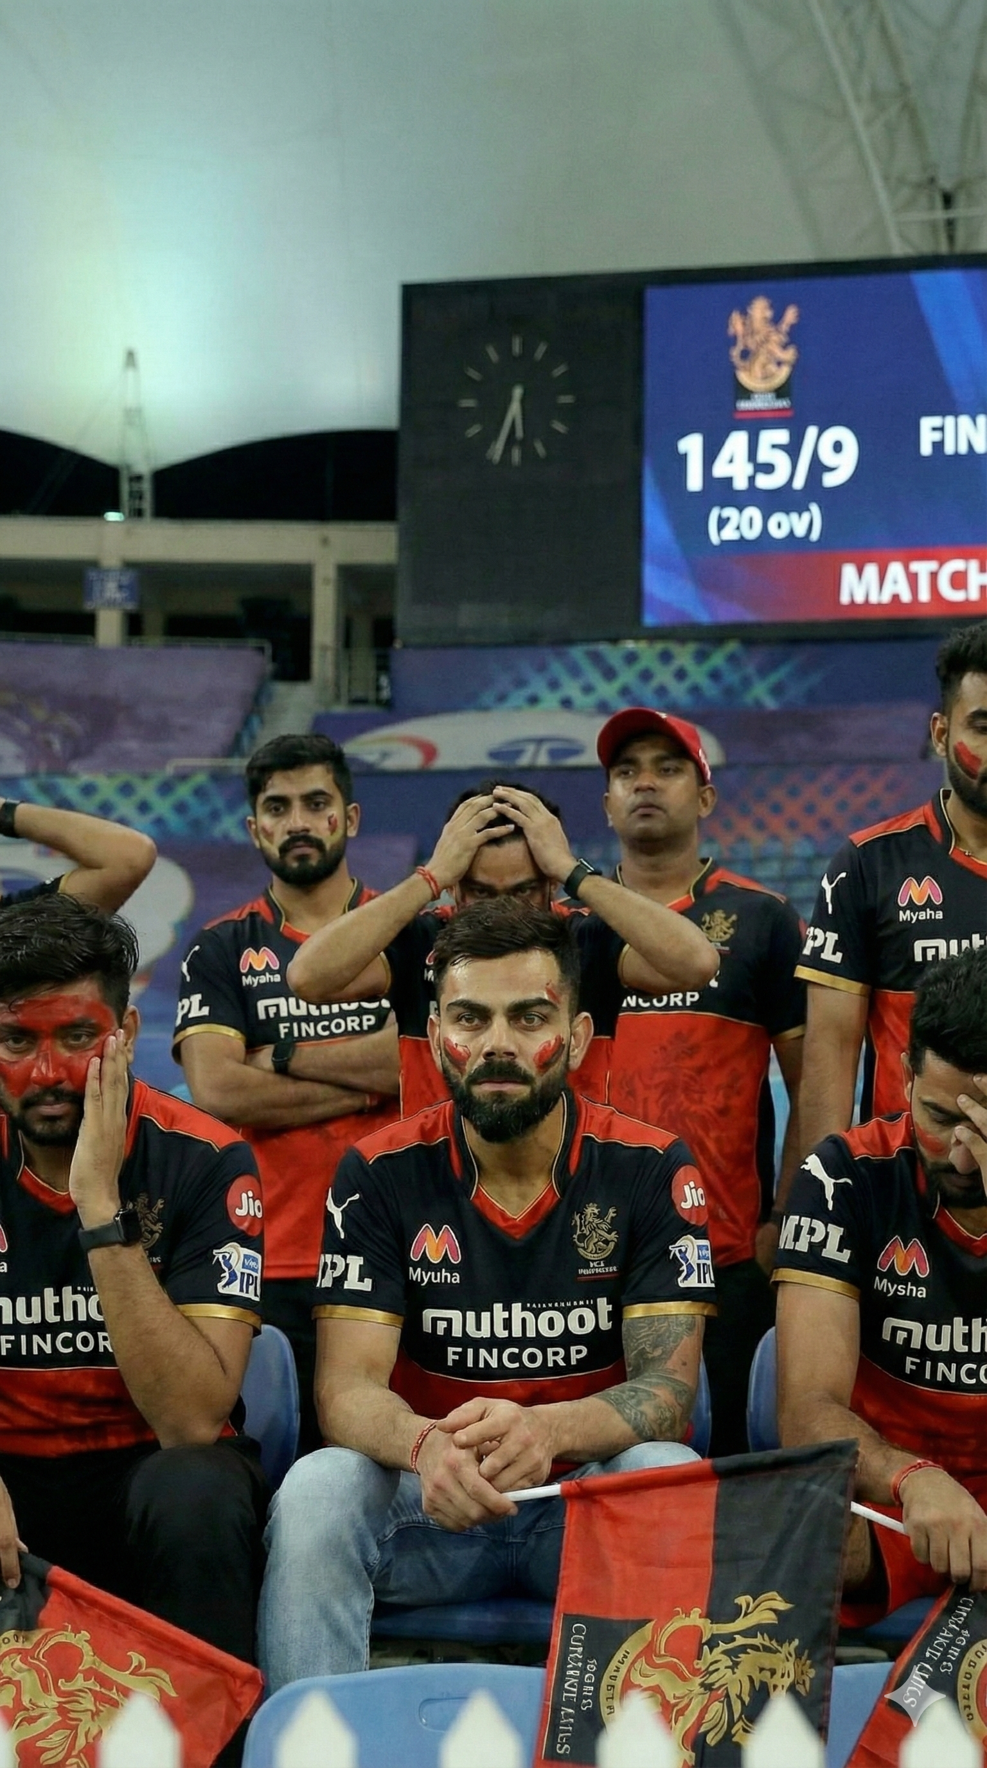
Key Reasons for the Trophy Drought
Season-wise inconsistency: Strong individual seasons were followed by sharp performance drop-offs, preventing sustained title momentum.
Tactical rigidity: Similar toss and match strategies were applied across different venues, ignoring pitch and condition variability.
Over-reliance on Star Players: The team's fate often hinged on a handful of top performers.
Inconsistent Bowling Unit: A lack of sustained quality and depth, particularly in death bowling.
Lack of All-Round Depth: Insufficient genuine multi-faceted players to provide balance.
Away Conditions Adaptation: Difficulty in performing consistently outside home ground advantage.
Squad Building Strategy: Focus on individual stars over a balanced team composition.

Slide 20
MEGA Auction Selection (Recommendation)
Match Changers:
Match-winning players deliver consistent runs across seasons.
High strike rate with stability is critical for T20 success.
Prioritize multi-season consistency over one-season spikes.
Adaptable players perform well across different match situations.
Focus on adaptability and long-term value in auction picks.
Build a resilient core, not short-term fixes.

Slide 21
MEGA Auction Selection (Recommendation)
All-Rounders:
All-rounders contribute with both bat and ball.
Enable flexible team combinations and strategies.
Reduce reliance on extra specialists.
Target proven match-impact all-rounders.
Strengthen middle-order stability and bowling depth.
Improve clutch performance in close games

Slide 22

Future-Ready Strategy Recommendations
A. Prioritize All-Rounders in Auctions
Build a balanced squad with flexible options across departments.
B. Strengthen Bowling Attack
Focus on death-overs and spin talent to reduce run leakage and boost wicket-taking consistency.
C. Adopt Venue-Based Squad Rotation
Tailor lineups to pitch and performance history across stadiums.
D. Enhance Tactical Decisions Using Data
Leverage win percentage, match-ups, and toss analysis to optimize on-field choices.
D. Integrate Advanced Analytics in Planning
Prepare for real-time strategy tools, predictive modeling, and opposition-based planning as outlined in the roadmap.

Slide 23
FINAL CONCLUSION
RCB’s success has been over-dependent on a few star players.
Lack of consistent wicket-taking weakened match control.
Batting strength existed, but bowling depth and all-rounders were insufficient.
Venue and matchup-based strategies were underutilized.
Future success depends on balance, bowling strength, and versatile players.

Slide 24


